Slide 1

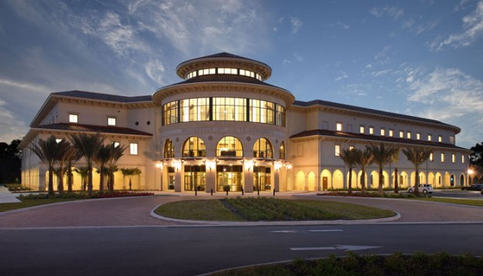
Week- 15 CAMS – Quality and Testing Dr. Bhuvan UNHELKAR IT Faculty, College Of Business; Office: C225; bunhelkar@sar.usf.edu; 941-359-4654

Slide 2

Agenda
Composite Agile: Quality and Testing (Chapter 9)
Quality Context – (Pages 315 – 322);
Quality Techniques & Agile Practice – (Pages 329 – 336) but NOT Table 9.4
Analyzing Risks in Testing (Pages 346 – 348)
"Agile job aids" (Selected Agile Practices).
Study of Agile Practice No 12 – Continuous Testing
Summary & Consolidation

Slide 3

Sub-Module Quality Context
Pages 315 - 322
© MethodScience; Material Designed and Presented by Dr. B. Unhelkar; drawn from The Art of Agile Practice

Slide 4
Figure 9.1: Quality & CAMS: Management, Assurance and Control
ISO9001; CMM-I
(Strategic, Holistic)
Management
(Organization)
Assurance
(Process)
Agile; Process-Maps; Estimations and Metrics
CAMS
Testing
(Control)
ISTQB; Test Tools;
(Tactical)

Slide 5
Strategic versus tactical aspects of quality
Quality
Management
Strategic
(project size and type issues)
Quality
Assurance
Process
issues
Quality
Control
Tactical
(unit versus acceptance test;
test beds, results, and other issues)

Slide 6
Assurance versus Control
Quality Assurance
Prevention of Errors
Quality Control
Detection of Errors
Agile Practices are most helpful in Quality Assurance (Prevention)
Continuous Testing also helps Prevention as Testing comes much earlier in an Agile process

Slide 7
Table 9.1 (Chapter 9 on Testing) : Quality Parameters
Correctness
Efficiency
Timeliness
Accuracy
Usability and
Effectiveness

Slide 8
Sub-Module Quality Techniques & Agile Practice
(Pages 329 – 336) but NOT Table 9.4
© MethodScience; Material Designed and Presented by Dr. B. Unhelkar; drawn from The Art of Agile Practice

Slide 9
Figure 9.4.: Applying Quality Techniques in Agile Projects
Audits
Showcases
Reviews
<- More Frequent ---- More Intense ->
Test harnesses
Workshops
Inspections
Interviews
Standups
Walkthroughs
Checklists
Quality Techniques & Agile

Slide 10
Figure 9.5: Three types of Quality Checks: Syntax, Semantics and Aesthetics
Semantic:
Is Customer Implied?
Or meant an Account?
Syntax:
Is the Rectangle Correct?
Or an Ellipse required?
Customer
Aesthetic:
Is this Pleasing to Read? Complete? Going Left to Right?
A syntactically correct model would ensure that if a rectangle has to represent an artifact, then literally ‘no corners have been cut’
A semantically correct model would ensure that when a Customer has to be represented, it is indeed a Customer and not another Entity
An aesthetically sound model will strive for balance. The representation of the Customer will not be too big or too small, will be readable and changeable. Also, it will not represent too many elements

Slide 11
Figure 9.6: Syntax, Semantics and Aesthetics verify and validate the Artifacts, Diagrams and Models (based on V&V of UML Models – John Wiley and Sons, 2006)
MODELS
(Showcase)
DIAGRAMS
(Walkthroughs)
ARTEFACTS
(User Stories; Classes; Testing)
Aesthetics
(Bird’s Eye View)
Validation
Semantics
Verification
(Standing View)
Syntax
(Ground-level View)

Slide 12
Figure 9.7: Applying V&V in CAMS (XP specific)
Iteration
An XP
Lifecycle
Final
Release
Prioritized
Stories
For
iteration
Pair
Programming
Updated
Release
Story
Cards
Small
Release
Integration
Testing
V&V Techniques
Interviews,
Walkthroughs;
Semantics;
Feasibility Study Estimation, Workshops;
Interviews;
Reviews
Test Harnesses; Standups; Checklists; Simulation; Analysis, Walkthroughs and Inspections (Req, Design, Code), Testing; Test Evaluation
Audits, Reviews ;
Showcases;
Interviews;
Testing;
Audits, Walkthroughs and Reviews
Acceptance
Testing

Slide 13
Sub-Module Development through Testing – TDD (Test Driven Development)
Based on Principles of Agile
© MethodScience; Material Designed and Presented by Dr. B. Unhelkar; drawn from The Art of Agile Practice

Slide 14
Figure 2.10: Test Driven Development
Write a Test Case
Develop a Feature Corresponding to the Test (Code)
Run the Test Case
Regression Testing
Refactor Code

Slide 15
TDD starts with eXtreme Programming (XP) (Beck 2000),
Two simple rules for TDD (Beck 2003).
First, you should write new business code only when an automated test has failed.
Second, you should eliminate any duplication that you find.

Slide 16
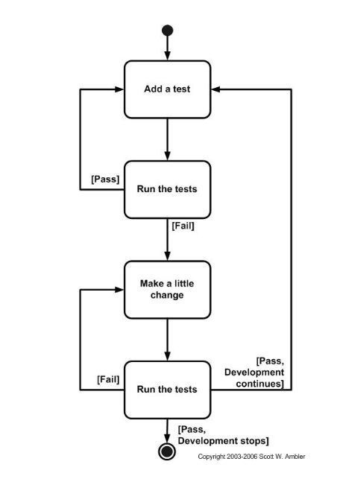

Slide 17
Beck explains how these two simple rules generate complex individual and group behavior:
You develop organically, with the running code providing feedback between decisions.
You write your own tests because you can't wait 20 times per day for someone else to write them for you.
Your development environment must provide rapid response to small changes (e.g you need a fast compiler and regression test suite).
Your designs must consist of highly cohesive, loosely coupled components (e.g. your design is highly normalized) to make testing easier (this also makes evolution and maintenance of your system easier too).

Slide 18
TDD – How to write good Test cases?
Effective short test cases written by developers themselves
Run fast (they have short setups, run times, and break downs).
Run in isolation (you should be able to reorder them).
Use data that makes them easy to read and to understand.
Use real data (e.g. copies of production data) when they need to.
Represent one step towards your overall goal.

Slide 19
Sub-Module Analyzing Risks in Testing
Especially in Agile Projects
(Pages 346 – 348)
© MethodScience; Material Designed and Presented by Dr. B. Unhelkar; drawn from The Art of Agile Practice

Slide 20
Testing Risks (Page 347)
Limited experience of staff specific to the technology being tested
Lack of importance of models
Non-availability of suitable test environment
Discovery of major errors later in the project
Lack of insufficient test data
Irrelevant Hardware
Lack of User awareness
Insufficient prioritization of testing

Slide 21
Sub-Module Agile Job Aids No.12 – Continuous Testing
And a Discussion Question
© MethodScience; Material Designed and Presented by Dr. B. Unhelkar

Slide 22


Slide 23
Conclusions & Future Directions
We discussed…??
Do you see what we see?

